Slide 1


TruckIT Webinar
Ticketing &
Back Office
An in depth look at our ticketing and back office tools
Live Q&A with the TruckIT support team

Slide 2

TRUCKIT WEBINAR
Webinar Roadmap
01
02
03
Capture & verify
Review & reconcile
Organize & act
• Automatic-PIC (ATP)
• Data on tickets
• Customer signatures
• Bulk Reconcile UI
• Tic Pic rejection
• Ticket rejection
• Parent & sub tickets
• Tags
• AI Search
• Exporting tickets
• Live Q&A
Ticketing & Back Office

Slide 3


TRUCKIT WEBINAR
Meet Your Hosts
James Nebeker
Dan Hall
Sr. Software Engineer
Sr. Marketing & Sales Strategist
• Product Expert
• Technical Support
• Artificial Intelligence
• Product Expert
• Product Marketing
• Logistics Technology
Bring your questions — the session closes with live Q&A.
Ticketing & Back Office

Slide 4
Digital Tickets

Slide 5
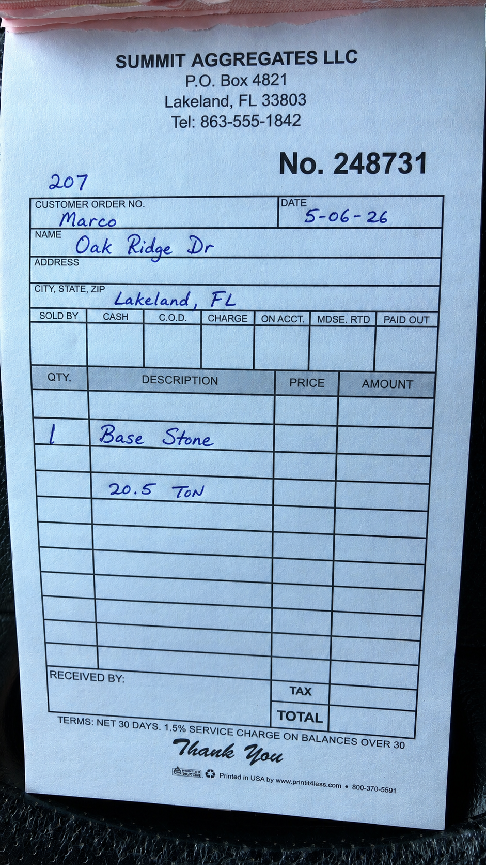
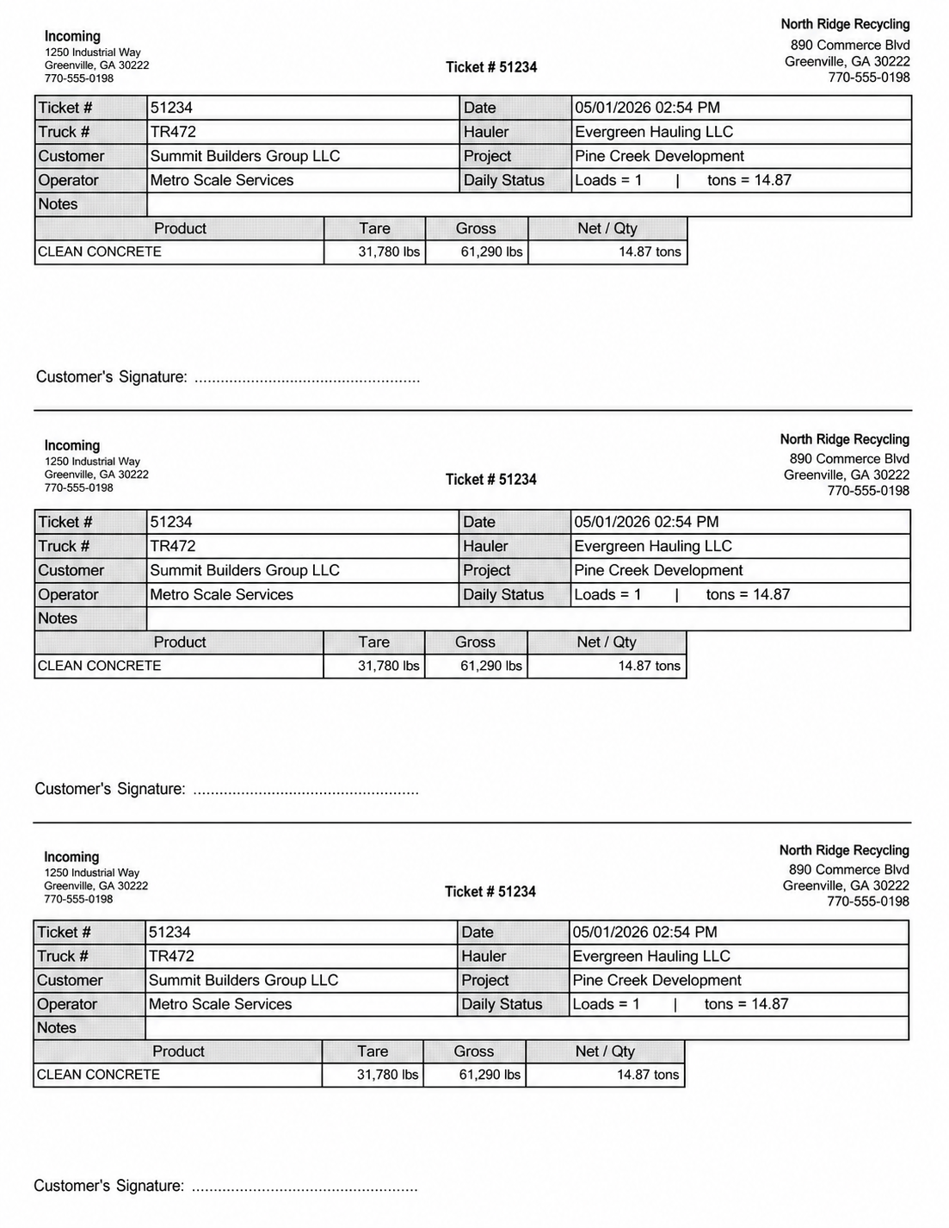
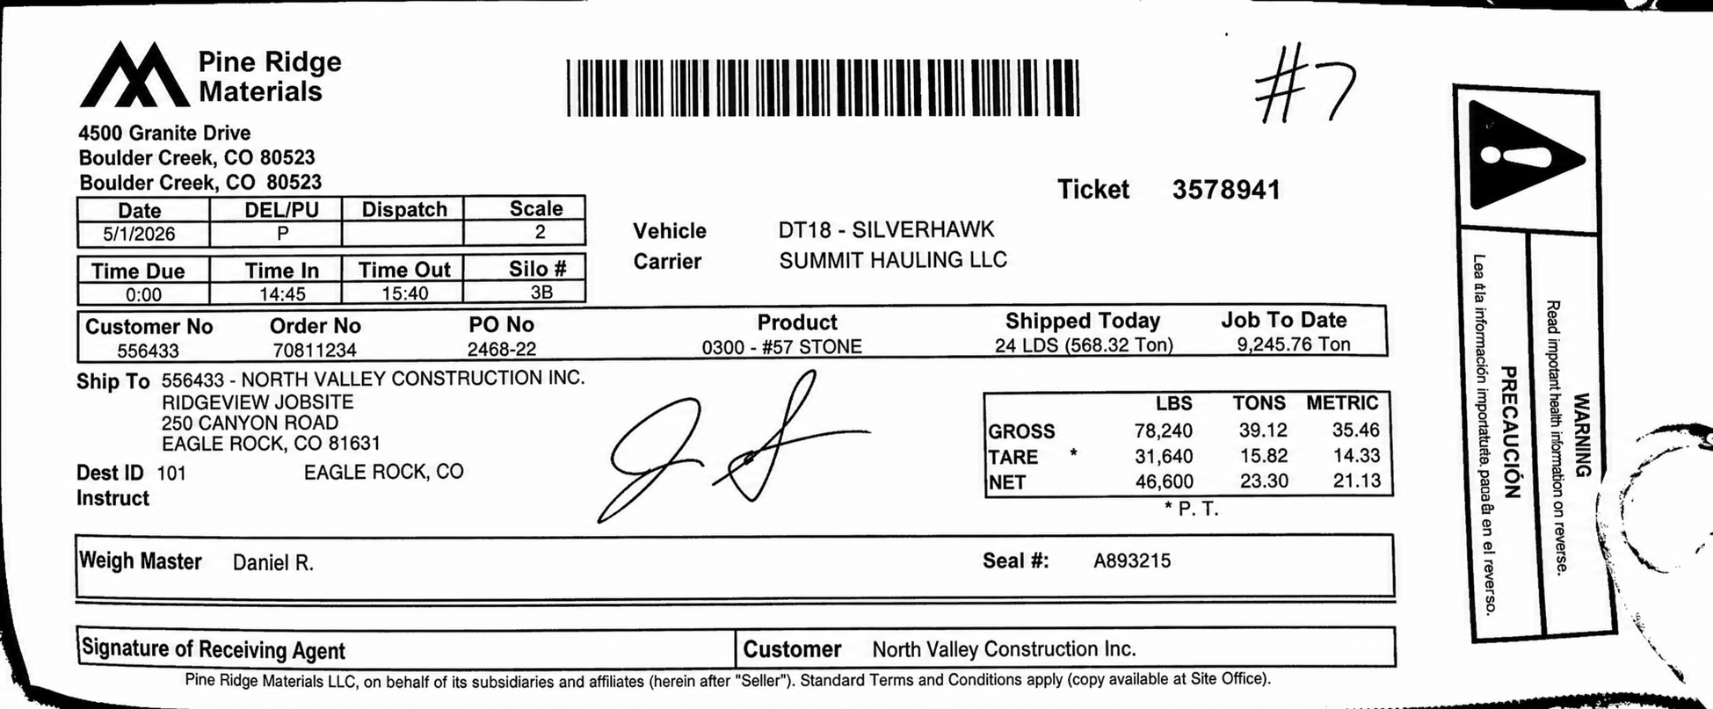
TRUCKIT WEBINAR
Three types of digital tickets
Ticket Photo | TicPic
Automatic-PIC | ATP
AirTicket
A photo of the paper ticket captured in the TruckIT app.
TruckIT’s AI tool for turning paper tickets into digital ticket data.
A digital ticket sent directly from the scalehouse into TruckIT.

Slide 6
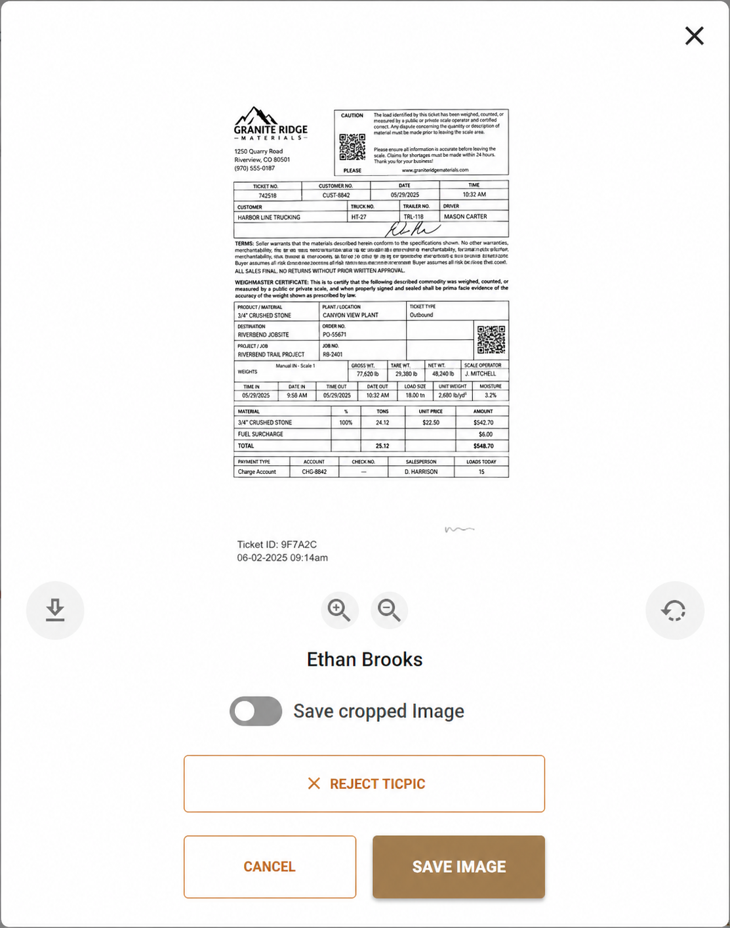
TRUCKIT WEBINAR
Automatic-PIC (ATP)
Automatic-PIC takes ticketing further by using AI and machine learning to digitize ticket data automatically.
Computer Vision enables the driver’s camera to precisely take an image of ANY paper ticket format. The driver only needs to point the camera in the right direction.
OCR and NLP identify and retrieve the critical ticket data from the photo using machine learning.
• No manual data entry by drivers
• Reduces administrative burden
• Supports faster billing and fewer unbilled tickets
• Improves cash flow with cleaner ticket data and reducing time to reconcile
Ticketing & Back Office

Slide 7
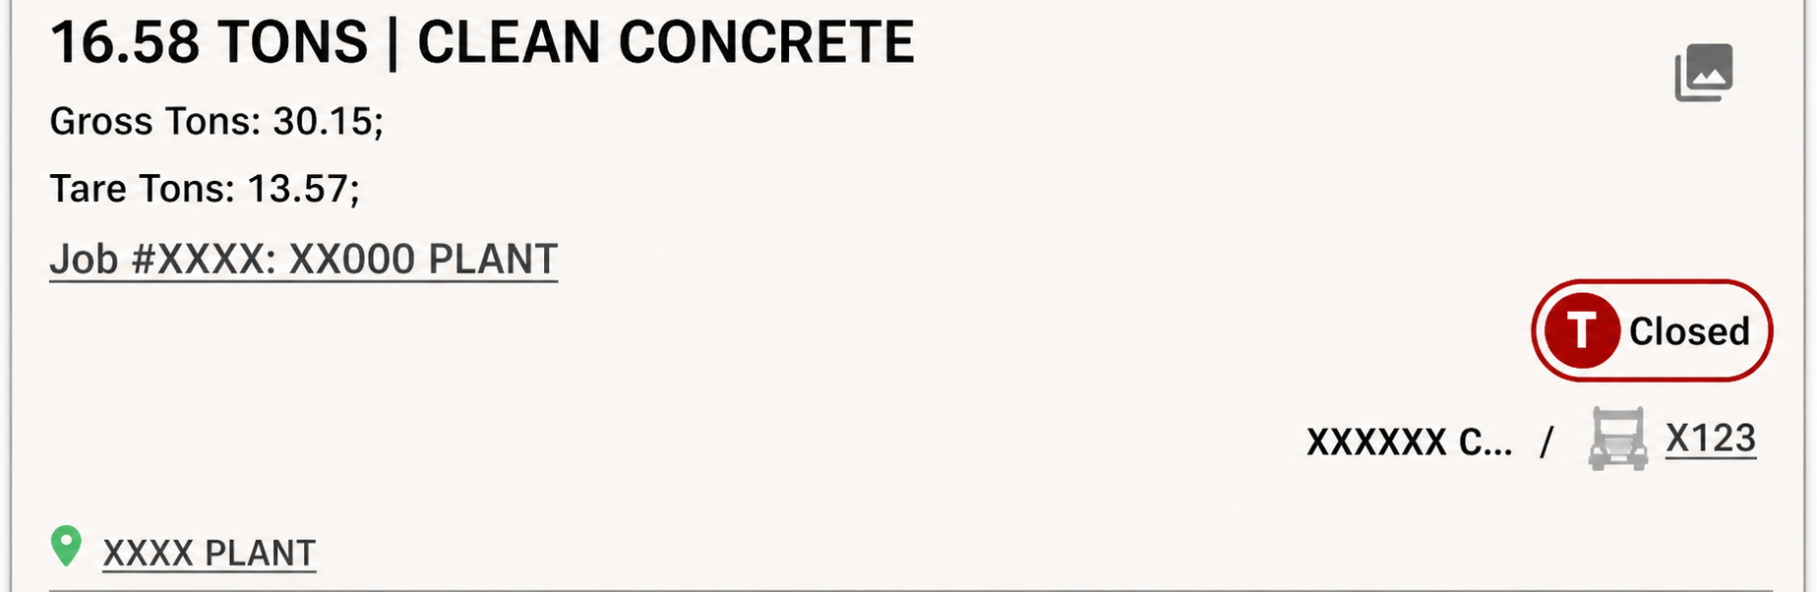
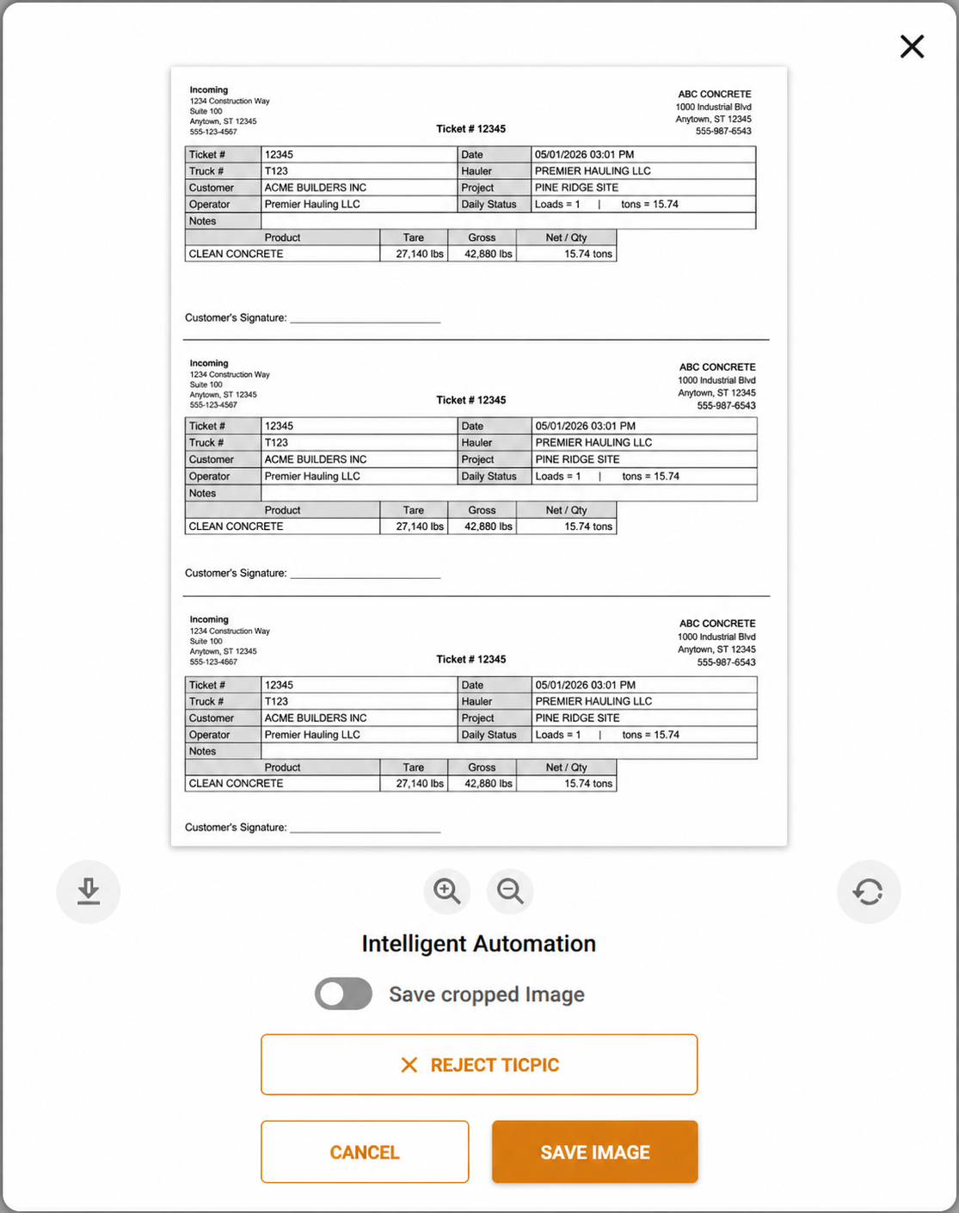
TRUCKIT WEBINAR
AirTicket™ is a patented technology that eliminates paper ticketing and replaces with a digital bill of lading.
AirTicket
HOW IT WORKS
AirTicket™ software is installed at the scalehouse within minutes
Driver rolls onto the scale to be weighed and truck identified for data matching
The scalehouse transmits corresponding digital ticket data which is stored in the cloud for immediate access
No manual ticket data entry required for driver or additional burden to scalehouse operator
Driver can roll off the scale without exiting their truck
RESULT
A fully automated paperless system for record keeping, reconciliation, material monitoring and billing
End to end real-time ticket data accessible throughout the material chain of custody with granted access
Combining with our Mobile Apps, provides material delivery confirmation and DOT Inspector
functionality
Project and Job summary reports with actionable Business Intelligence
Ticketing & Back Office

Slide 8
Ticket Data

Slide 9
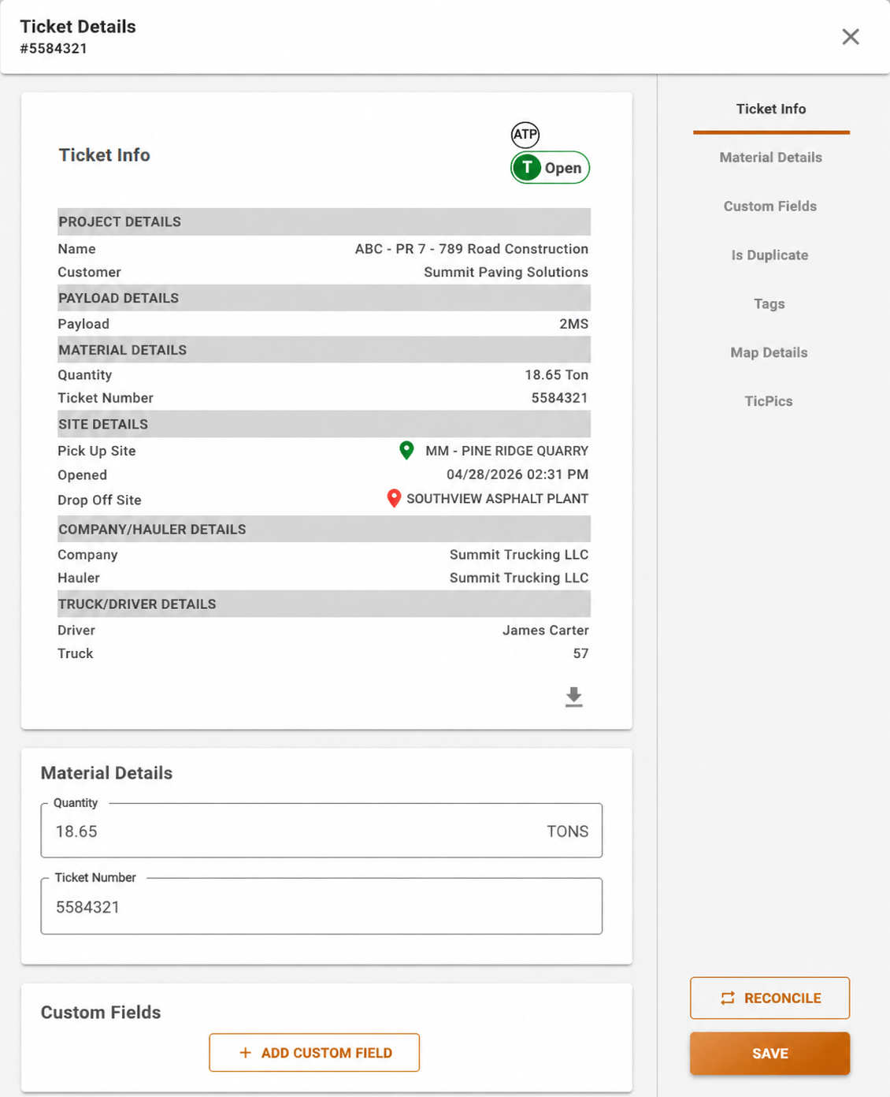
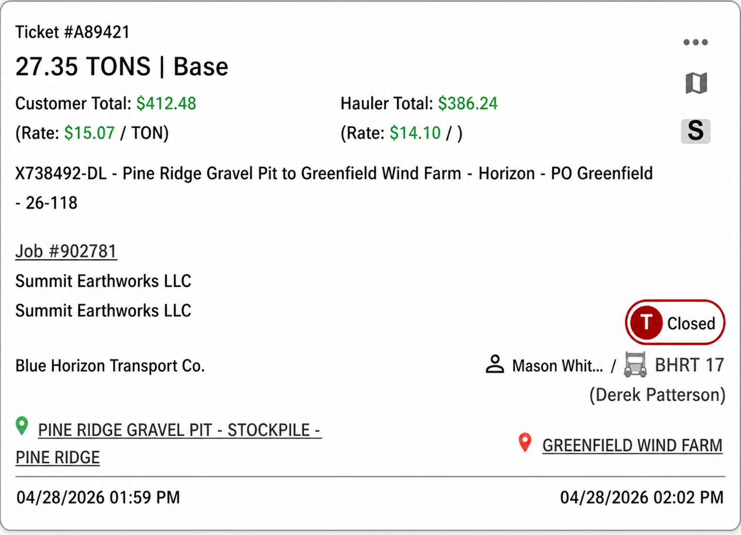
TRUCKIT WEBINAR
Data on Tickets
Key fields visible on each ticket
• Ticket #, UoM, project name, job number
• Customer, total customer cost, rate/UoM
• Total driver pay, rate/UoM
• Driver/truck and ticket status
• ATP Ticket or AirTicket indicator
Signature, Parent or Sub-Ticket
Ticketing & Back Office

Slide 10
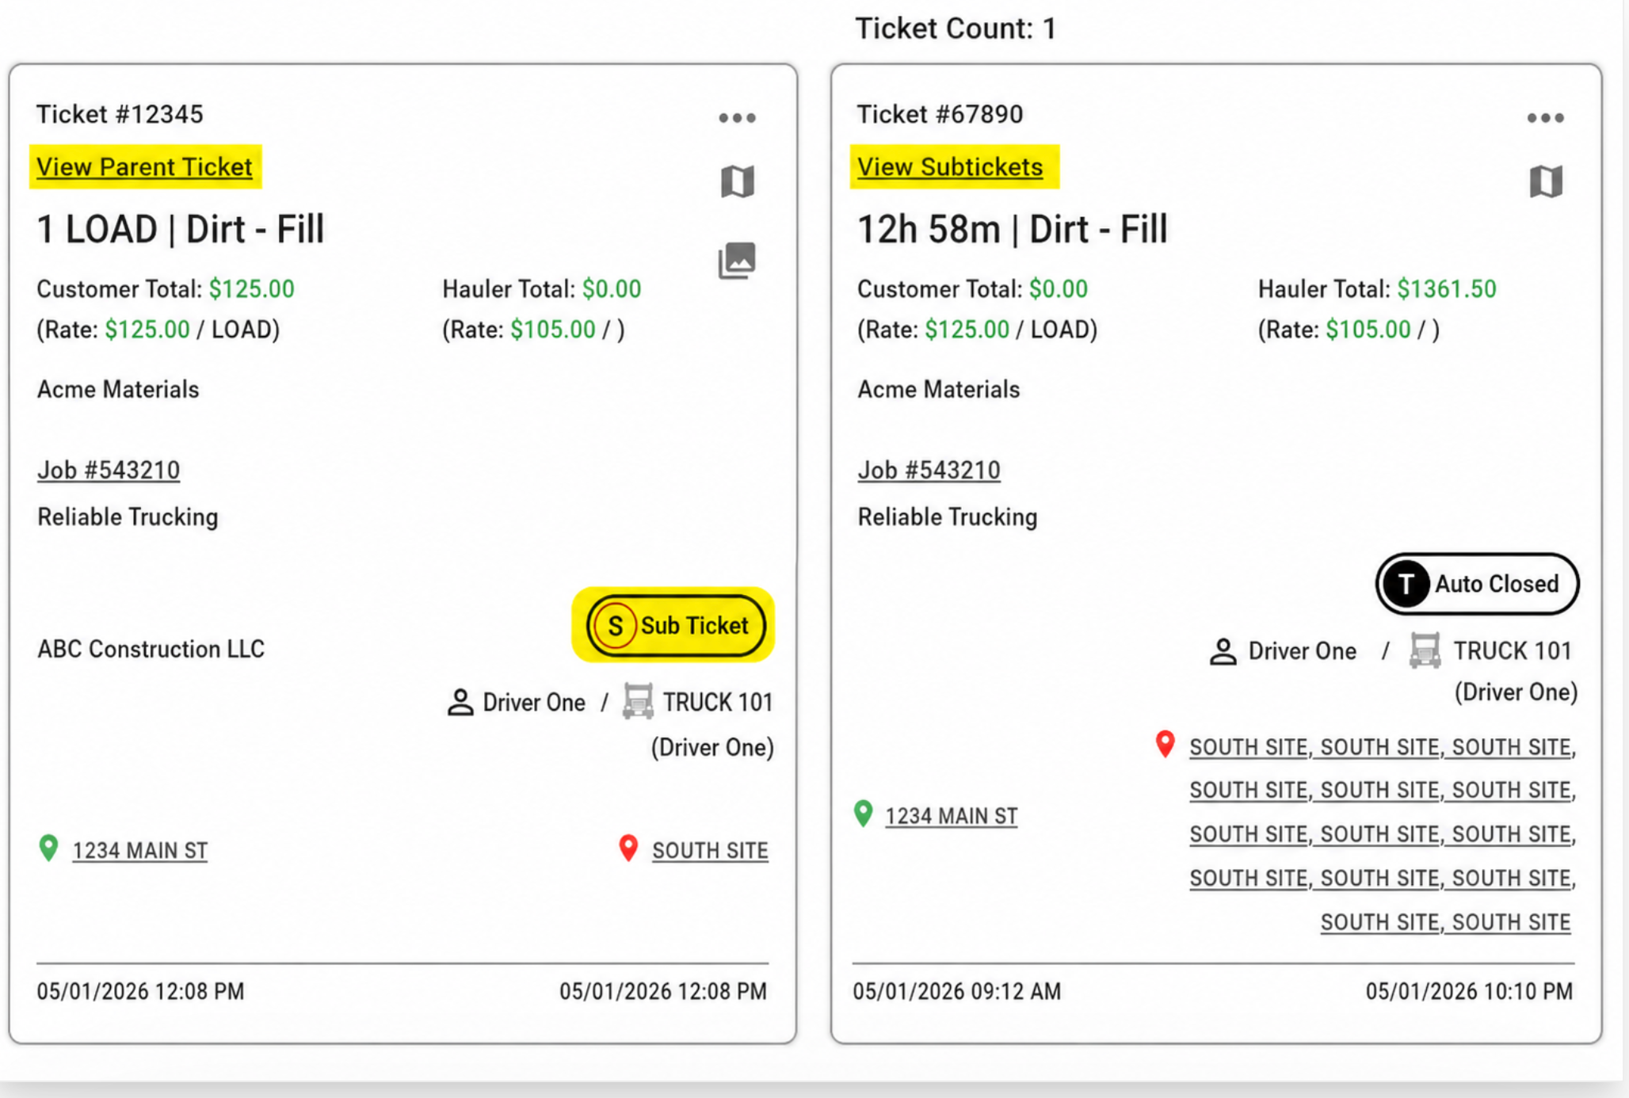
TRUCKIT WEBINAR
Parent & Sub Tickets
For hourly or load-based jobs, create a Parent Ticket / Sub Ticket relationship.
Parent Tickets
Show total hours or loads on a job
Do not represent material or tonnage
Sub Tickets
Capture quantity of material transported by load, ton, or yard.
Ticketing & Back Office

Slide 11
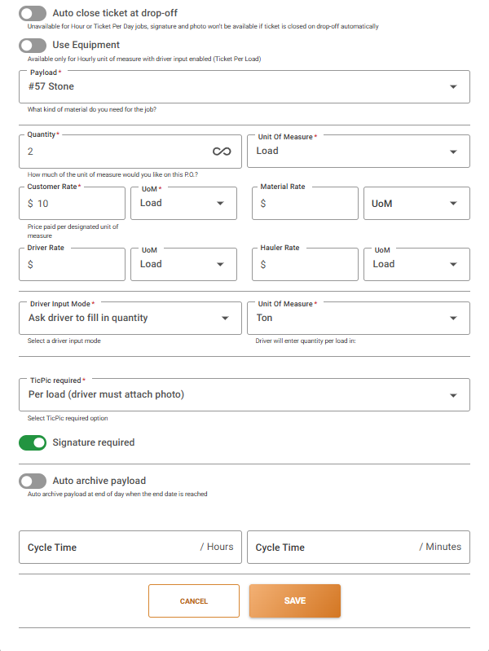
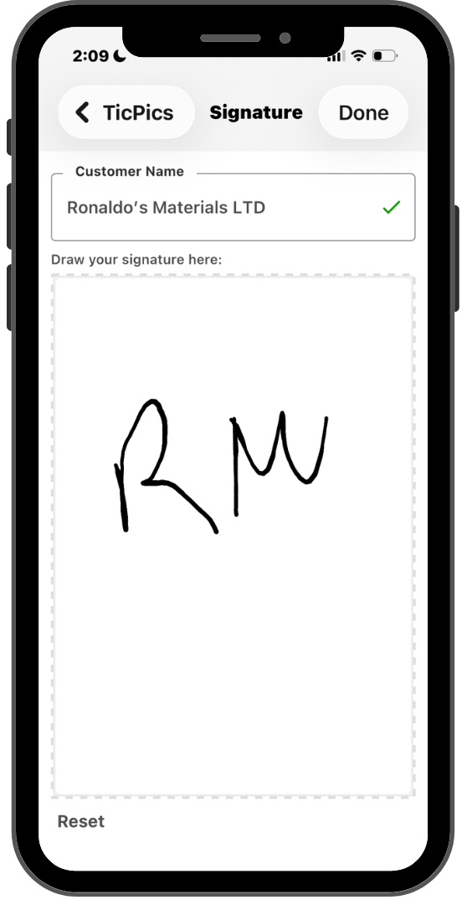
TRUCKIT WEBINAR
Customer Signature on Payload
PAYLOAD SETUP
MOBILE SIGNATURE
TICKET SIGNATURE
Validate delivery and capture onsite confirmation directly in the workflow.
• Toggle the setting “ON” when creating the payload line item
• Mobile App prompts the customer for a signature
• Signature is attached to the ticket with a date and time stamp
Ticketing & Back Office

Slide 12
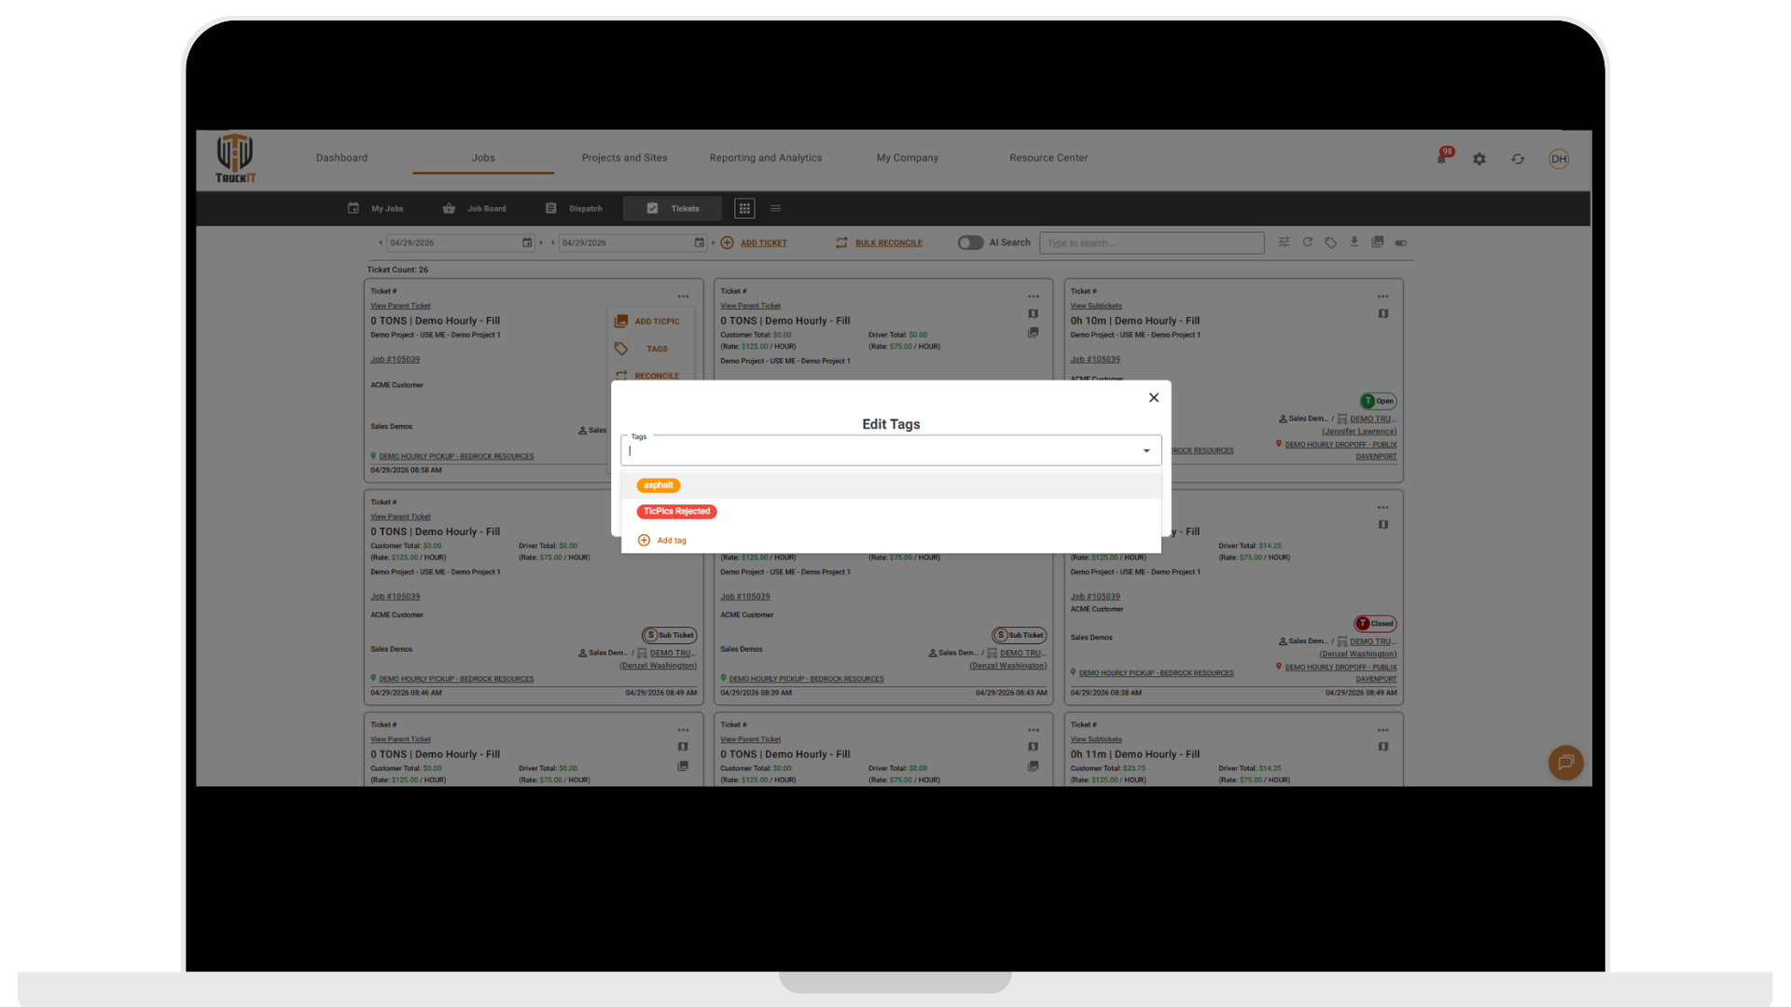
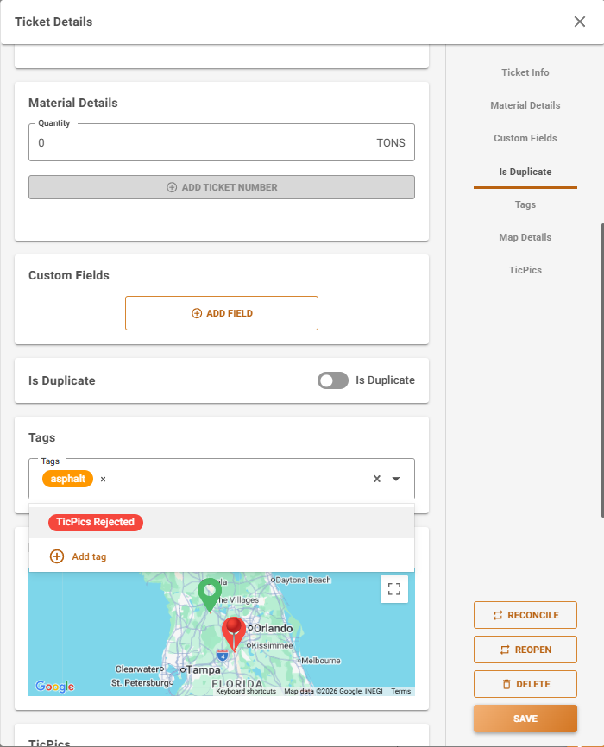
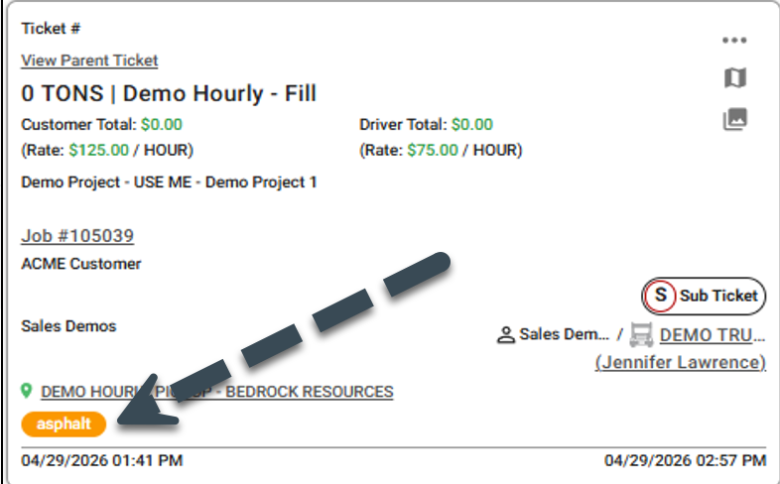
TRUCKIT WEBINAR
Tags
Tags help teams organize, filter, and quickly locate the tickets they need.
• Identify tickets by unique identifiers
• Filter tickets when more information is needed
• Filter by material type
• Pair with other customization features
Ticketing & Back Office

Slide 13
Ticket Actions

Slide 14
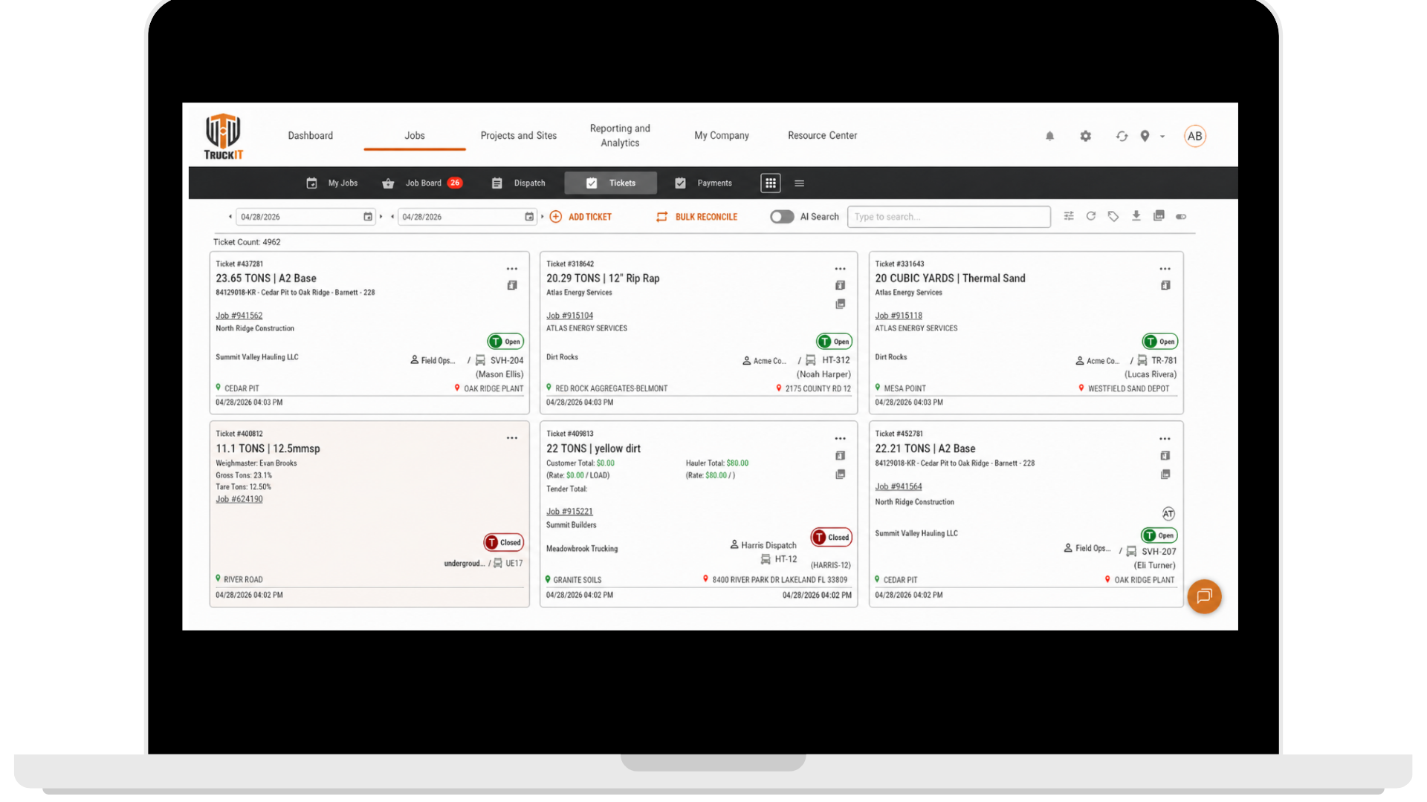
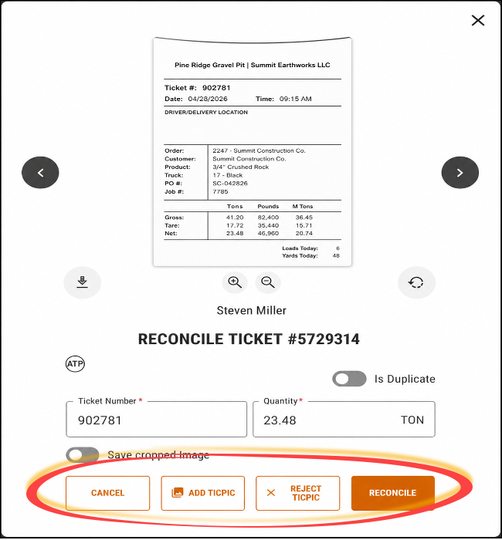
TRUCKIT WEBINAR
New Bulk Reconcile UI
Quickly view uploaded ticket images to validate load data.
Accept/Reject Images
Add Images
Reconcile tickets in real-time
Identify & remove duplicate tickets
Ticketing & Back Office

Slide 15
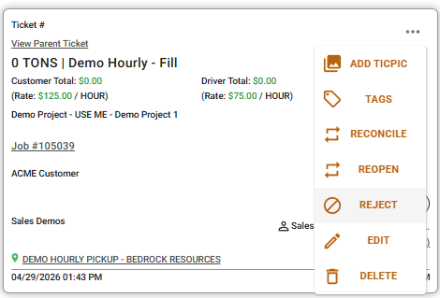
TRUCKIT WEBINAR
Ticket Rejection
Manage exceptions directly in the ticket workflow so teams know what needs to be corrected.
• Reject problematic tickets
• Document review outcomes
• Protect downstream billing and reporting workflows
Ticketing & Back Office

Slide 16
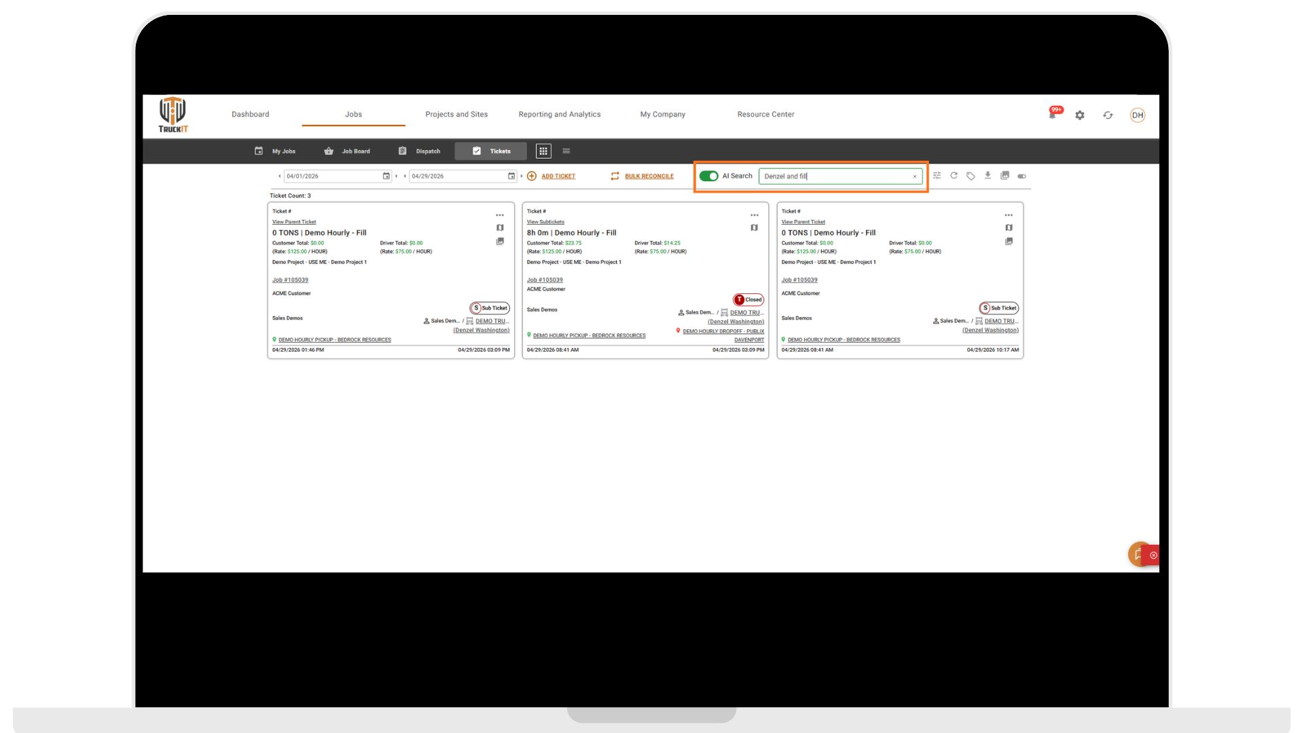
TRUCKIT WEBINAR
AI Search
Revamped search helps teams find what they’re looking for faster.
• More human understanding of prompts
• No exact match required
• Run complex searches
• Search multiple criteria at once, such as driver and material
Ticketing & Back Office

Slide 17
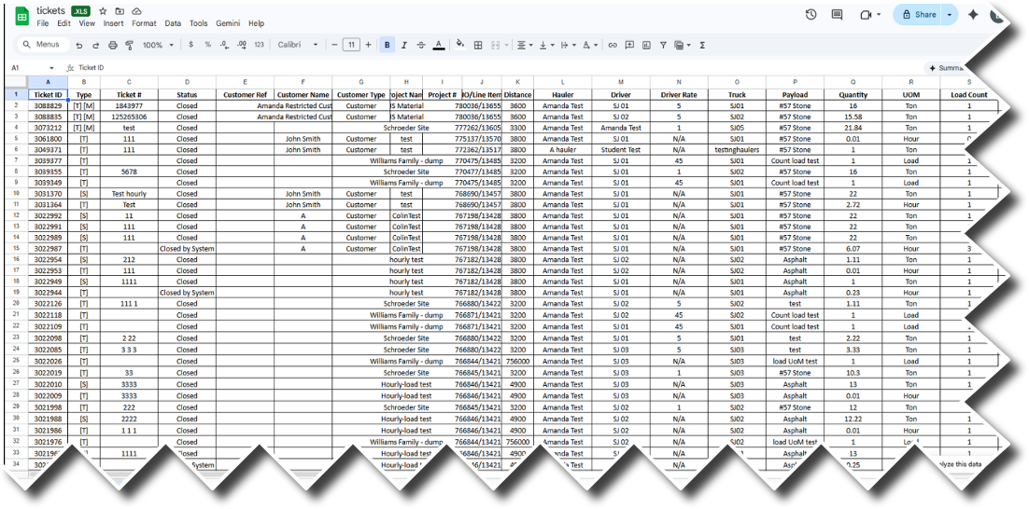
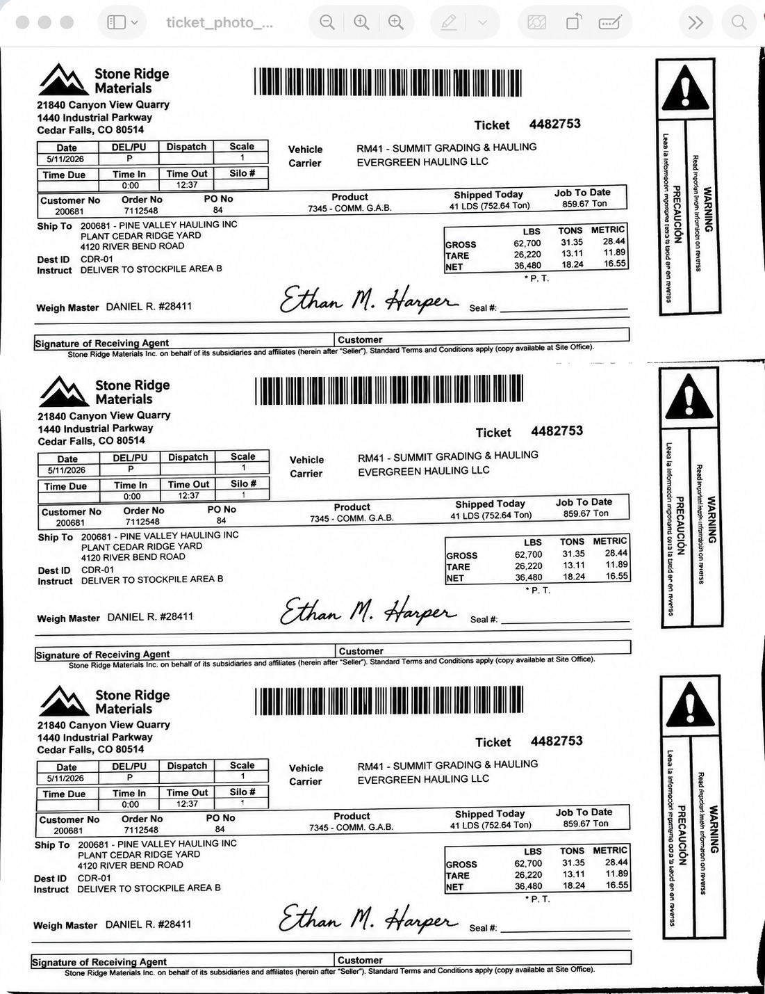
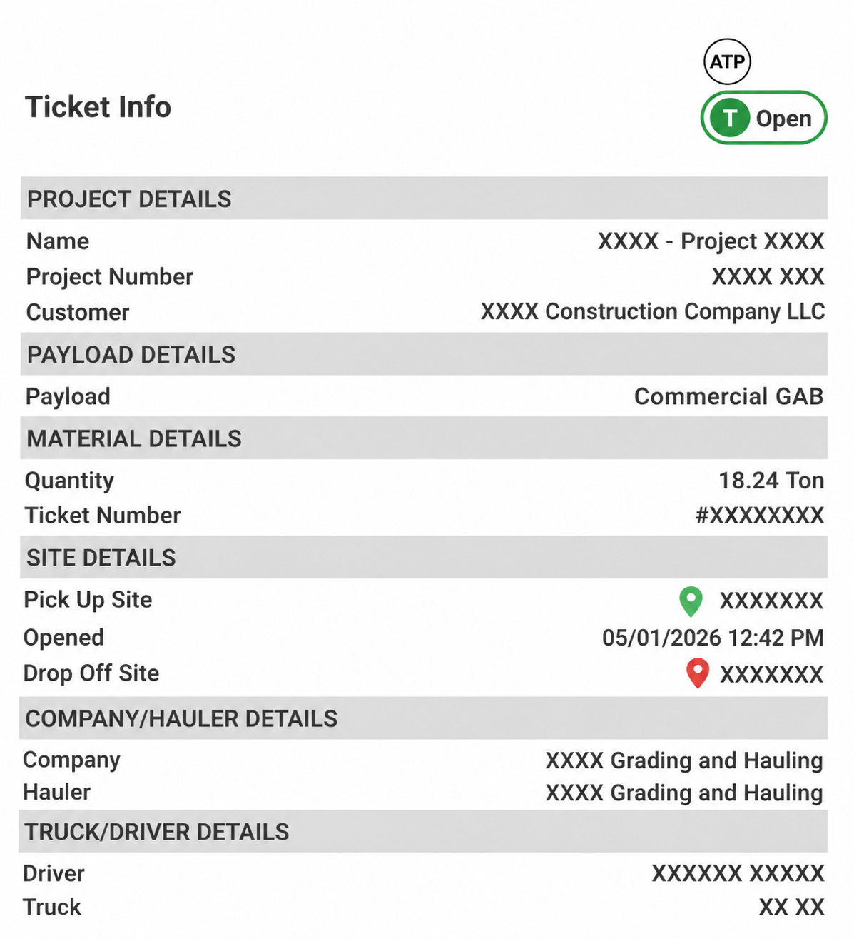
TRUCKIT WEBINAR
Exporting Tickets
Move ticket data where it needs to go: files, photos, back office systems, or custom integrations.
File Exports
Export ticket data to Excel/CSV
Download ticket images
Ticketing & Back Office

Slide 18
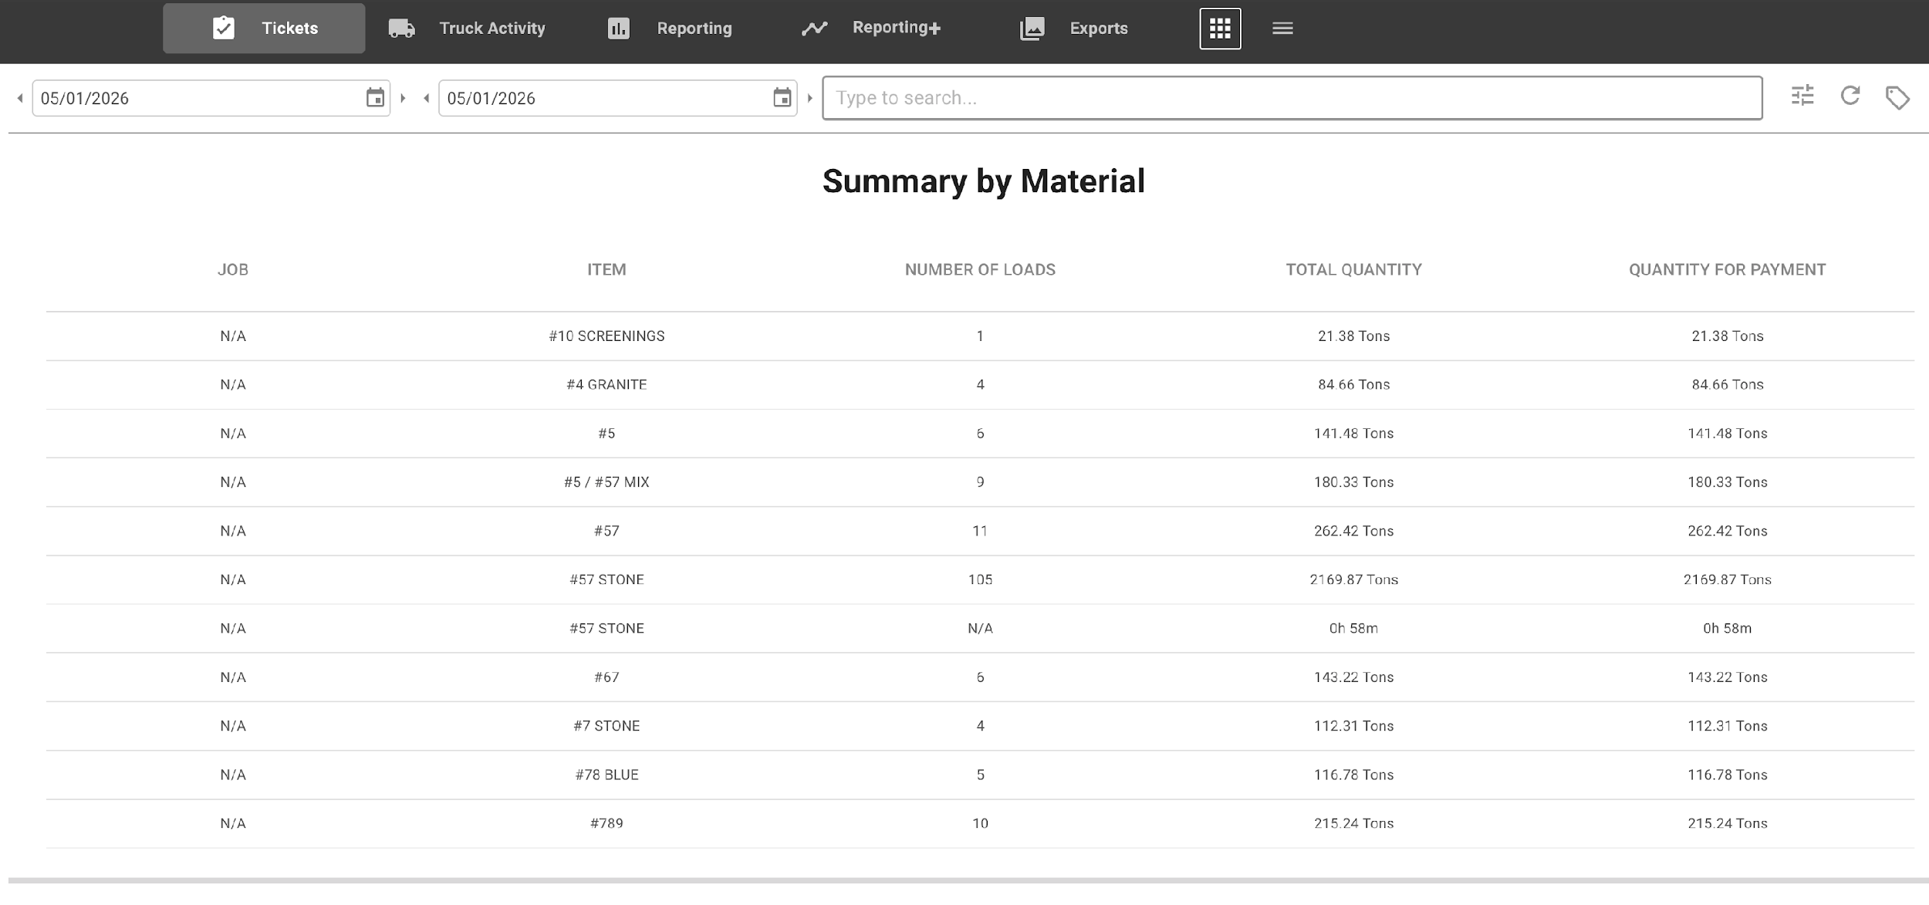
TRUCKIT WEBINAR
Reporting & Analytics
Using the “Tickets” tab beneath Reporting & Analytics you can filter and view a summary of construction materials over a selected time frame reflected by quantities, material types, loads, and view the corresponding tickets associated with your search.
Ticketing & Back Office

Slide 19











TRUCKIT WEBINAR
Integration Partners
TruckIT is API driven which means we integrate with IoT devices (hardware), ERP’s, accounting software, existing business systems, payroll software, scalehouses, and MORE.
BENEFITS:
Real-time, accessible & accurate data
Digital records
Less data entry, errors, & disputes
Bill and pay faster
Accelerated cash flow
Actionable business intelligence
Performance analytics

Slide 20
TRUCKIT WEBINAR
Software Integrations
TruckIT’s value-driven technology integrates with IoT devices, accounting software, existing business systems, scalehouses, and MORE.
Due to volume & lack of integration, 95.5%
of all construction data remains unused.
Enterprise
Gives teams one connected view of operations, customers, projects, and performance.
Accounting
Speeds up billing, reduces errors, and helps customers get paid faster.
Payroll
Reduces manual payroll work by connecting driver, truck, ticket, and hour data.
78%
REDUCTION
TIME SPENT
MANAGING TICKETS
Scalehouse
Eliminates paper ticket delays by capturing accurate ticket data at the source.
Construction Management
Keeps project stakeholders aligned with real-time material, ticket, and delivery data.
IoT
Improves fleet visibility, asset tracking, and operational decision-making in real time.
Ticketing & Back Office

Slide 21
TRUCKIT WEBINAR
Webinar Recap
Ticketing & back office workflow recap: from capture to cash.
01
Capture & verify
ATP turns ticket photos into digital data; required fields and customer signatures verify delivery.
02
Review & reconcile
Bulk Reconcile, Tic Pic rejection, ticket rejection, and duplicate cleanup protect billing accuracy.
03
Organize & act
Tags, AI Search, exports, and integrations make ticket data searchable, shareable, and usable.
Result: fewer manual touches • cleaner data • faster reconciliation • stronger cash flow
Ticketing & Back Office

Slide 22
Thank you
Ticketing & Back Office
Live Q&A

Slide 23
TRUCKIT WEBINAR
Future Webinars
Keep building product fluency with upcoming TruckIT sessions.
01
Project Creation
Set up projects, payloads, and job foundations.
02
Dispatching
Plan, assign, and monitor work more efficiently.
03
Admin Tools
Manage settings, users, and team workflows.
Have an idea for a future topic? Bring it to Q&A.
Ticketing & Back Office

